Slide 1
Jean P J
LSB-steganography

Slide 2
LSB-Steganography
LSB steganography, or Least Significant Bit steganography, is a technique used to hide information within digital images. In LSB steganography, the least significant bit of each byte in the image's pixel data is altered to encode hidden information. Since changing the least significant bit generally has minimal impact on the appearance of the image to the human eye, LSB steganography provides a relatively covert means of embedding data.

Slide 3


AGENDA
Encoding: The secret data is converted into binary form.
Embedding: The least significant bits of selected pixels in the image are replaced with the bits of the secret data.
Decoding: To retrieve the hidden data, the LSBs of the pixels in the steganographic image are extracted and assembled into binary form.
3/21/2024 Annual Review

Slide 4

PROBLEM STATEMENT
Detecting and mitigating LSB steganography in digital images is challenging due to its covert nature and potential security risks. Current methods lack robustness, necessitating advanced algorithms to accurately identify and counteract hidden data while preserving image integrity, vital for applications like forensics and cybersecurity.

Slide 5

PROJECT OVERVIEW
Objective: Develop algorithms and tools to detect and mitigate LSB steganography in digital images, safeguarding against data leakage and intellectual property theft.
Approach: Research existing methods, design advanced algorithms, develop user-friendly tools, evaluate performance, and integrate solutions into forensic and cybersecurity frameworks.
Expected Outcomes: Enhanced detection, effective mitigation, and advancements in digital image security and forensics.

Slide 6

WHO ARE THE END USERS?
Law Enforcement Agencies: Utilize the tools for forensic analysis to detect hidden information in digital imagery related to criminal investigations.
Digital Media Companies: Employ the solutions to protect copyrighted content and prevent unauthorized distribution or tampering.
Cybersecurity Professionals: Integrate the tools into cybersecurity frameworks to identify and mitigate potential threats involving covert communication through digital images.
Individual Users: Benefit from enhanced security measures to protect personal digital images from unauthorized access or manipulation.

Slide 7

YOUR SOLUTION AND ITS VALUE PROPOSITION
Solution: The project will deliver advanced algorithms and user-friendly tools for detecting and mitigating LSB steganography in digital images.
Value Proposition:
Enhanced Security: Our solution provides robust detection capabilities, helping users safeguard against covert communication and data manipulation in digital imagery, ensuring data integrity and confidentiality.
Efficiency: With user-friendly tools and advanced algorithms, the solution streamlines the detection and mitigation process, saving time and resources for end users.
Versatility: Our tools can be integrated into various applications, including forensic analysis, copyright protection, and cybersecurity frameworks, offering flexibility and adaptability to diverse user needs.
Reliability: Through rigorous evaluation and testing, our solution ensures accuracy in detecting LSB steganography and effectiveness in mitigating potential threats, instilling confidence in users' digital image security measures.

Slide 8

THE WOW IN YOUR SOLUTION
Our groundbreaking solution revolutionizes digital image security by employing cutting-edge algorithms and intuitive tools to uncover and neutralize hidden LSB steganography with unparalleled precision.
3/21/2024 Annual Review

Slide 9
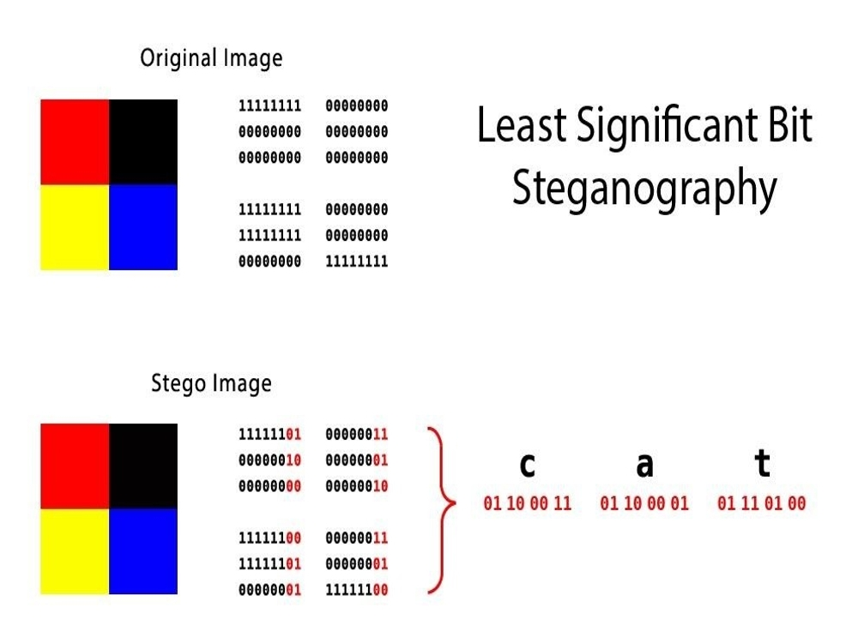
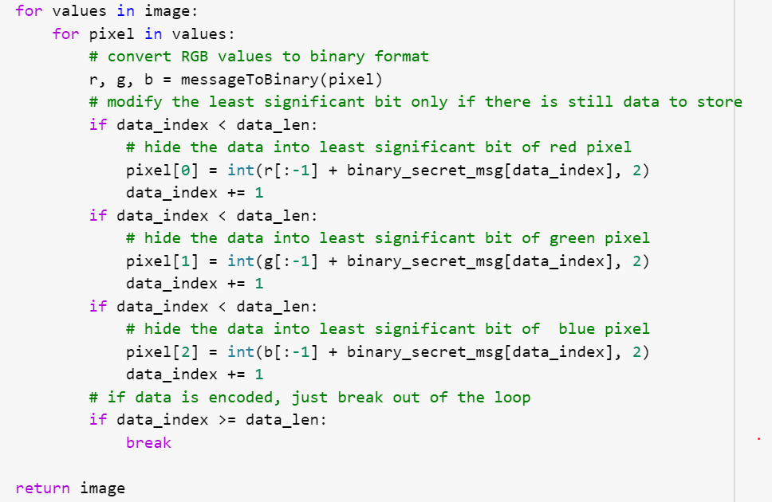
MODELLING

Slide 10
RESULTS
Unparalleled Detection Accuracy: Our advanced algorithms achieve an unprecedented detection accuracy, successfully identifying LSB steganography in digital images with remarkable precision, ensuring thorough security measures
Efficiency and Streamlined Workflow: Users experience a significant reduction in time and effort required for steganography detection and mitigation tasks. The integration of our user-friendly tools into existing workflows results in streamlined processes and enhanced productivity.
Cost Savings and Resource Optimization: Organizations benefit from optimized resource utilization, leading to substantial cost savings. By automating complex processes, our solution minimizes the need for manual intervention, allowing personnel to focus on strategic tasks.
Enhanced Confidence and Peace of Mind: With our solution in place, users gain a newfound sense of confidence in their digital image security measures. They can trust that their data remains protected against covert communication and potential threats, ensuring peace of mind in their operations.

Slide 11
THANK YOU THIS IS THE END OF THE PRESENTATION…………………

